Slide 1
Social media analytics using knowledge graph
AKSHAY SAXENA (BDA 01)
DIVIJ BHUTANI (BDA 02)
CHANDAN KAMAL (BDA 03)

Slide 2
Abstract
Our aim is to provide a complete analytical solution to understand customer feedbacks through twitter data and visualize this data using a knowledge graph to help a brand/ company/ organization make changes to their product/service for better customer satisfaction.

Slide 3
Introduction
This project concerns about scraping data from twitter and visualising it so as to form speculations. The amount of data scrapped is in conjunction with reflections customers and user convey through the Tweets.
The analysis done can give insights such as pin pointing the direct relationships between twitter users, content of tweet and information regarding that. Based on Tweets, insights drawn are easy to understand.
The certain important keywords which convey and imparts meaning to the tweets can be sorted out with this project. Such as location the users are mentioning in their tweets regarding certain issue or product.

Slide 4
Technologies used
Platform: Jupyter Notebook
For Tweet Extraction: Python, Twint, PySpark
For Knowledge Graphs: Neo4j

Slide 5
Libraries
1) OS & Sys:- The os and sys modules provide numerous tools to deal with filenames, paths, directories.
2) Numpy:- Used for scientific computing in python and provide tools for working with arrays.
3) Pandas:- It provides high-performance, easy to use structures and data analysis tools.
4) Nest_asyncio:- asyncio does not allow its event loop to be nested.
5) Findspark:-Without any arguments, the SPARK_HOME environment variable will be used. Provides findspark.init() to make pyspark importable as a regular library.
6) Twint:- It is Used to scraping Tweets from Twitter profiles without using Twitter's API.

Slide 6
Software and Hardware Requirements
Minimum Hardware requirements:
OS: Windows, Linux, Mac
Minimum 2 GB Ram
2 GHz Processor
Minimum of 5 GB Storage
Minimum Software requirements:
Platform: Colab Notebook
For Tweet Extraction: Python, Twint, PySpark, Optimus
For Knowledge Graphs: Neo4j

Slide 7
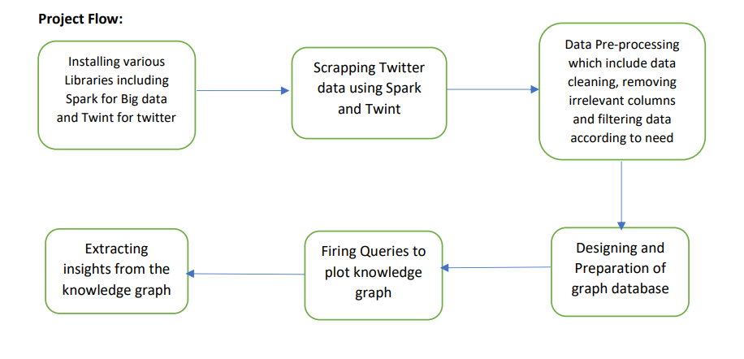
Project Flow

Slide 8
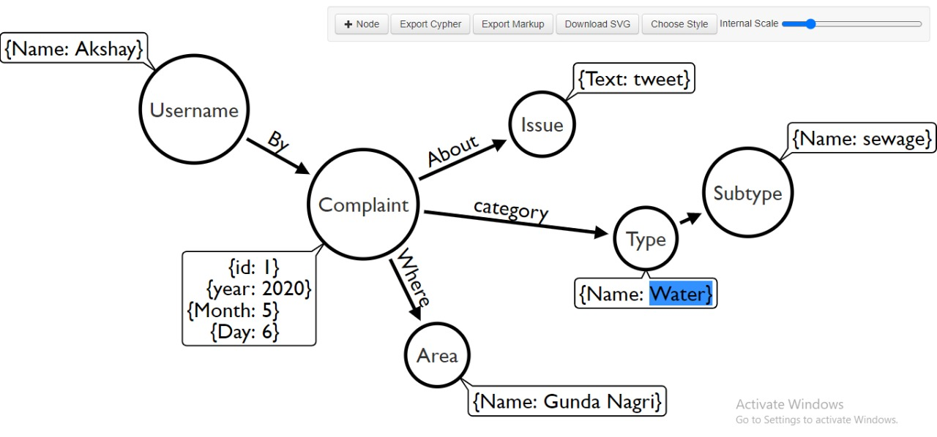
Graph Database

Slide 9
What is Neo4j?
Unlike traditional databases, which arrange data in rows, columns and tables, Neo4j has a flexible structure defined by stored relationships between data records.
With Neo4j, each data record, or node, stores direct pointers to all the nodes it’s connected to. Because Neo4j is designed around this simple, yet powerful optimization, it performs queries with complex connections orders of magnitude faster, and with more depth, than other databases.

Slide 10
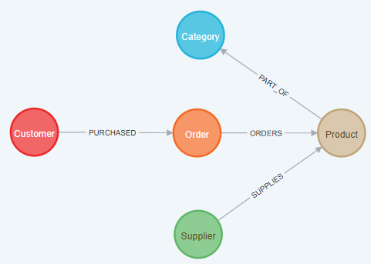

Slide 11
NEO4J QUERIES
LOAD CSV WITH HEADERS FROM "file:///C:/tweets.csv" AS row
CREATE (c:Complaint {Complaint:row.Complaint})
MERGE (u:Username {Username:row.Username})<-[:BY]-(c)
MERGE (d:Date {Date:row.Date})<-[:ON]-(c)
MERGE (i:Issue_type {Issue_type:row.Issue_type})<-[:ABOUT]-(c)
MERGE (t:Company {Company:row.Company})<-[:FOR]-(c)

Slide 12
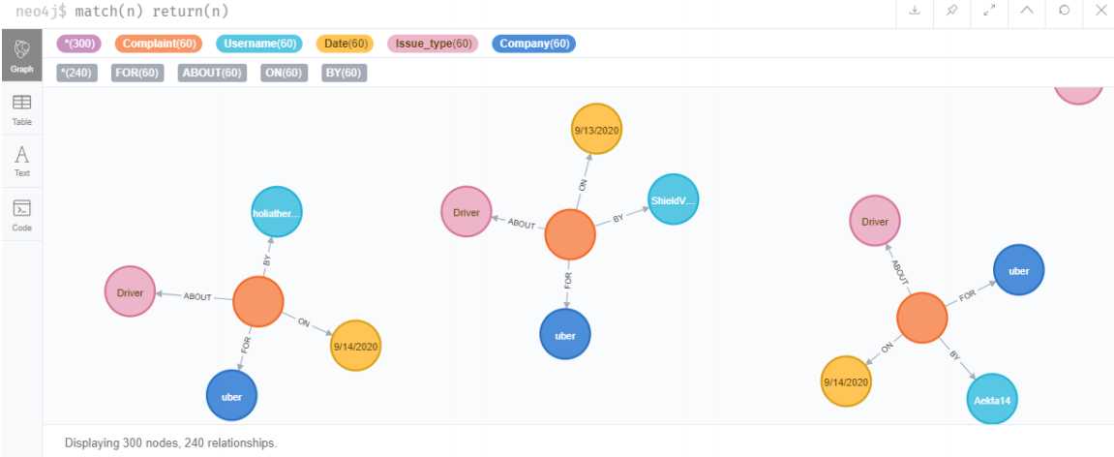
NEO4J GRAPH

Slide 13
Conclusion
Thus, we were successful in implementing knowledge graph using Neo4j on Twitter data and were able to find relationships between various columns generated from it using python code.

Slide 14
Future Scope
Implementing a user friendly GUI using Django framework of Python Language.

Slide 15
References
List of references
https://pypi.org/project/twint/
https://neo4j.com/
https://twitter.com/

